Slide 1
Garfield Prep Academy
No Days Off!
Kennard Branch, Principal
Roz Williams, social worker

Slide 2
Our School Demographics
314 Students
In-boundary 70% / Out-of boundary 30%
Grades PK3 – 5
Economically Disadvantaged – 100%
Special Education – 13%
3 CES Programs
PK 3/4
K-2
3-5

Slide 3
Chronic ABSENTEEISM AT GARFIELD, An Old Problem IN SERACH OF NEW ANSWERS
Historical Chronic Attendance Data for the last 3 Years
2015 – 2016 – YTD: 18.5%
2016 – 2017 – YTD: 31.3%
2017 – 2018 – YTD: 25.7%

Slide 4
A HIDDEN EDUCATIONAL CRISIS
According to Research from Attendance Works
20% of low income kids miss too much school and are more likely to suffer academically.
25% of homeless students are chronically absent.
40% of transient students miss too much school when families move around to various parts of the city.
Children living in poverty are two to three times more likely to be chronically absent—and face the most harm because their community lacks the resources to make up for the lost learning in school. Students from communities of color as well as those with disabilities are disproportionately affected.
While chronic absence presents academic challenges for students not in class, when it reaches high levels in a classroom or school, all students may suffer because the resulting classroom churn hampers teachers’ ability to engage all students and meet their learning needs.

Slide 5
Recommendations from the Research
In order to increase school attendance there has to be a team based approach to tackling the challenges that families and schools face.
One person can’t do this work alone. It has to involve multiple representatives from various stakeholder groups.
Policies can help with attendance, but the foundation of improving student attendance begins with relationships and changing the mindset of families.
School attendance is often a manifestation of a greater social challenge.

Slide 6
What’s the Difference Between Chronic Absence and Truancy?
A Great Misconception

Slide 7
Proactive APPROACH
Garfield Prep's News and Announcements
Personalized Early Outreach
Social Media Campaigns
Incentives
Address Health Needs
Friday Morning Pep Rally
Recognizing Good and Improved Attendance

Slide 8
TIERed system of supports for improving attendance
Tier 1: Awareness and prevention for all children and families all year round.
Tier 2: Personalized outreach to families of children missing 10-19 percent of days enrolled.
Tier 3: Targeted intervention with families of children missing 20 percent or more of days enrolled.
Notes:
The goal of Tier 2 is to reduce absences to less than 10 percent. The 10 percent trigger for outreach requires Garfield staff and parents or caregivers to analyze why absences occur and problem solve together to reduce the impediments.
Teachers don’t have to handle this alone. Early education program staff—such as family outreach or the school nurse—can reach out to families with Tier 2 and 3 interventions when absences begin to add up.
You can also clear up any misconceptions as some parents still think that absences are only a problem if they're unexcused. Did You Know...campaign on ClassDojo
The goal of Tier 3 strategies is to provide intensified support to parents, to address the misconceptions, barriers and negative experiences that impede attendance and help them connect to community social and medical services as needed to reduce chronic absence.
Tier 3 strategies start with a discussion between parents or caregivers that leads to an agreed upon plan between parents and staff, with a timetable for actions each will take to reduce chronic absence. My Child’s Success Plan can help document the results of a discussion and capture the commitments both parents and the preschool program have made.

Slide 9
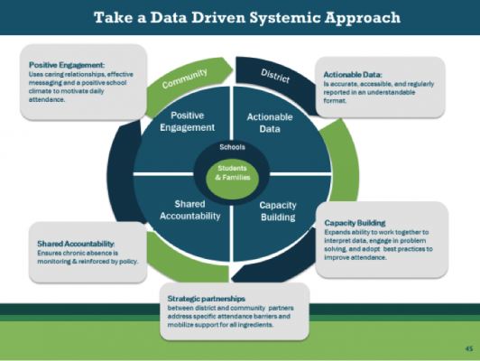
SCHOOL-WIDE INITIATIVE
We've Developed Programmatic Responses to our Most Frequent Barriers
Uniform Bank – tops, bottoms, socks and under garments
Blazers for Boys and Girls
Improved Access to Healthcare – Nurse attends all Kid-Talk and RtI Attendance Meetings
Tutoring
Mentoring (B.O.Y.S. and G.I.R.L.S. SEL Groups)
Before and Afterschool Care
(New) Safe Passage
CSC Component of Impact – Our school policy helps us ensure that chronic absence is monitored and reinforced
Notes:
Capacity Building
It is essential to build the skills and knowledge of your staff and community partners to understand what chronic absence is, why it matters for student achievement and success, how it differs from truancy, and how to respond effectively by organizing a multi-tiered approach to reducing absenteeism.
Shared Accountability
Teachers and administrators are more likely to pay attention to chronic absence when it is built into accountability systems. Speak how attendance monitoring falls into CSC for all staff members.

Slide 10
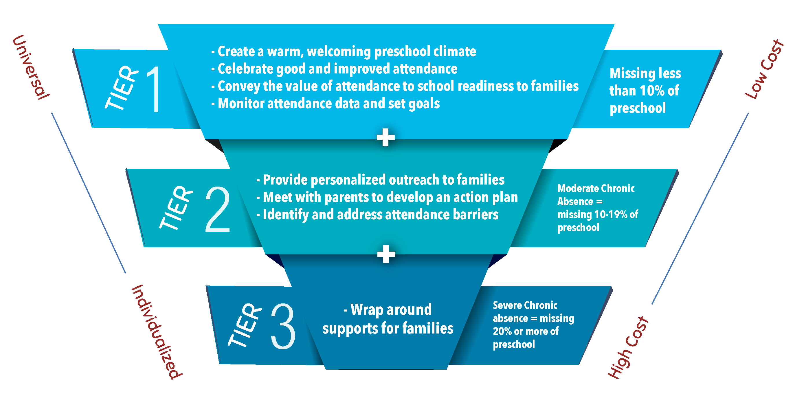
Using the data wisely
The best way to identify students with chronic absence, is to use the attendance data already collected by or sent schools to examine which and how many students are missing 10% or more of the school year.
Use data to monitor trends over time by grade and subgroup.
Use data prior to the beginning of the school year to assess how many students are likely to need additional supports and then determine how to put in place sufficient resources.

Slide 11
Engaging Families in preventing chronic absence
Many parents and students don’t realize how quickly early absences can add up to academic trouble. Community members and teachers can educate families and build a culture of attendance through early outreach, incentives and attention to data.
Social Worker
ECE – Monthly Attendance Breakfasts for 3 and 4 year-old families
Attendance, Behavior and Curriculum (ABC's of Garfield) Monthly Parent Meetings – Conduct Illustrating the Gap Interactive Exercise Illustrating the Gap
Central Office Attendance Specialist
Teachers
OECE
Far Southeast Family Strengthening Collaborative
Show Up, Stand Out

Slide 12
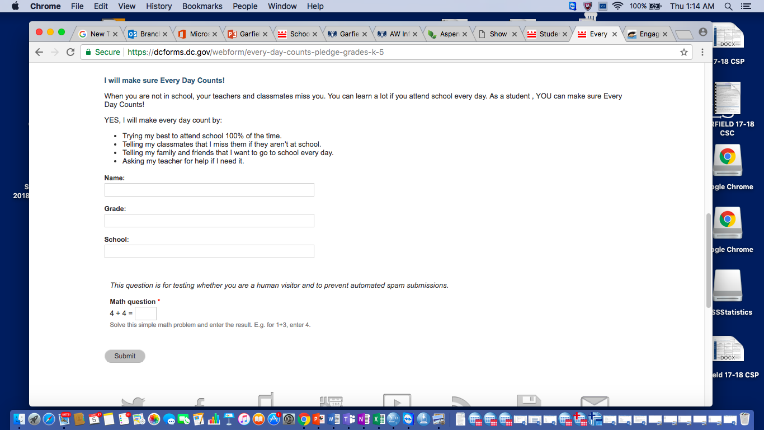
Engaging Children in preventing chronic absence
(New) Online Attendance Pledge
Students on our Attendance Committee
(New for SY 18-19) Perfectly Punctual Campaign and Student Attendance Score Card for ECE Perfectly Punctual Campaign

Slide 13
Meet the A-team
Garfield's Attendance Committee
MS. WILLIAMS (SOCIAL WORKER)
MS. DUNMORE (EDUCATIONAL AIDE)
MS. DENNY (DBH CLINICIAN)
MS. P. ALSTON (PTA VICE PRESIDENT)
IKEYA PYLES (STUDENT REPRESENTATIVE)
SHANTEL BONNER (STUDENT REPRESENTATIVE)

Slide 14
GOALS
In- Seat Attendance – 92% or higher & Chronic Absences – 10% or less
Year-Long Messaging
Summer – Home Visits
August/September - Orientation Meetings and Attendance Awareness Month
October – Begin Student Recognition Ceremonies
November – Parent and Student Attendance Celebration & Holiday Basket Giveaway
December – Winter Performance – Honor Grandparents and Student Attendance
January – Attendance Olympics (Gold, Silver and Bronze Medals)
February – 100th Day of School Attendance Celebration
March – Read Across America Day and Attendance Messages
April – Honor Parents for National Volunteer Week
May – Plan School-wide Move up Month – Focus on Next Year's Attendance
June – End-of-Year Parent and Student Recognition

Slide 15
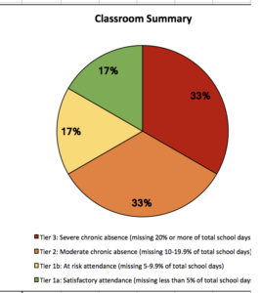
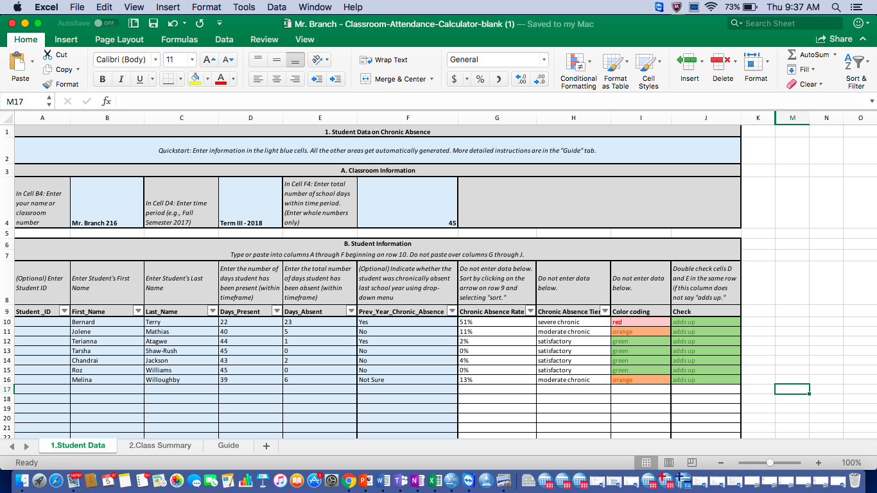
Teacher Friendly Resource
Classroom Attendance Calculator from Attendance Works
This is a self-calculating spreadsheet to help identify the students who have so many absences they require some form of early intervention.
The calculator includes a step-by-step guide to fill in the spreadsheet, and a worksheet that allows educators to assess the steps they are taking now and what more they can do to reduce chronic absence.

Slide 16
QUESTIONS and/or Follow-up kennard.branch@dc.goV Roz.williams@dc.gov

